Slide 2
DA THINGUM
Lessons Learned from Translation
09/30/2024

Slide 3
TOOLS

Slide 4
Python
Scripts
Use of API for Elasticsearch: creation and management of indices, documents and mappings.
Huggingface library for importing and using different models, particularly transformers for text and image embeddings.
Optical character recognition using Tesseract.
Development of proof-of-concept web apps using Streamlit.
API for LLMs: OpenAI, Claude, Azure AI Translator.
Approach to fine-tuning Llama 3.
Evaluation of Punctuation Instructions in English-Portuguese Translation Model.

Slide 5
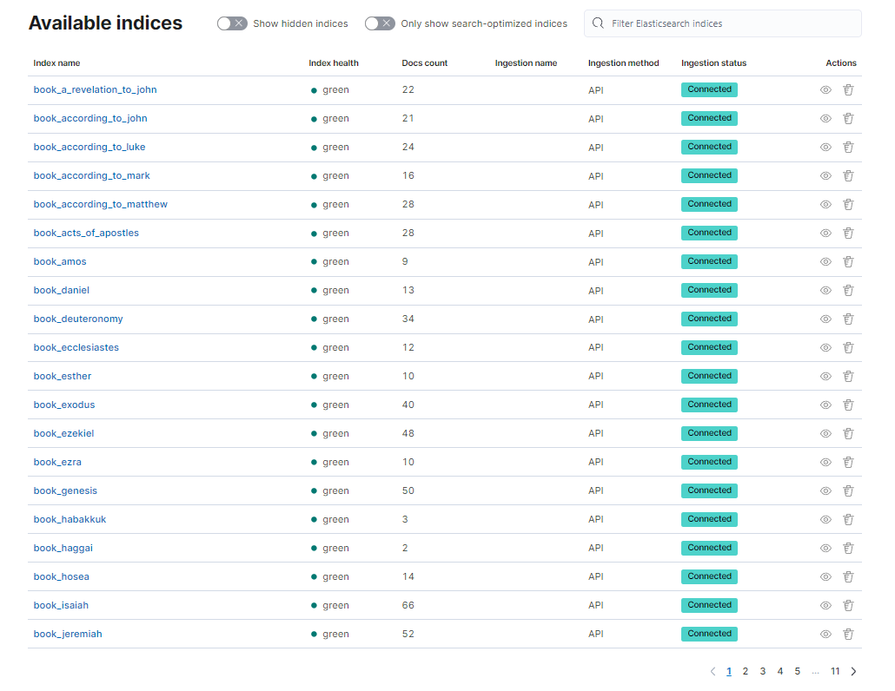
Elastic
Stack
Indexing:
All the books of the Bible are indexed in Elasticsearch, which makes it possible to search or consult any of them even using natural language (such as speaking to any smart chat).

Slide 6
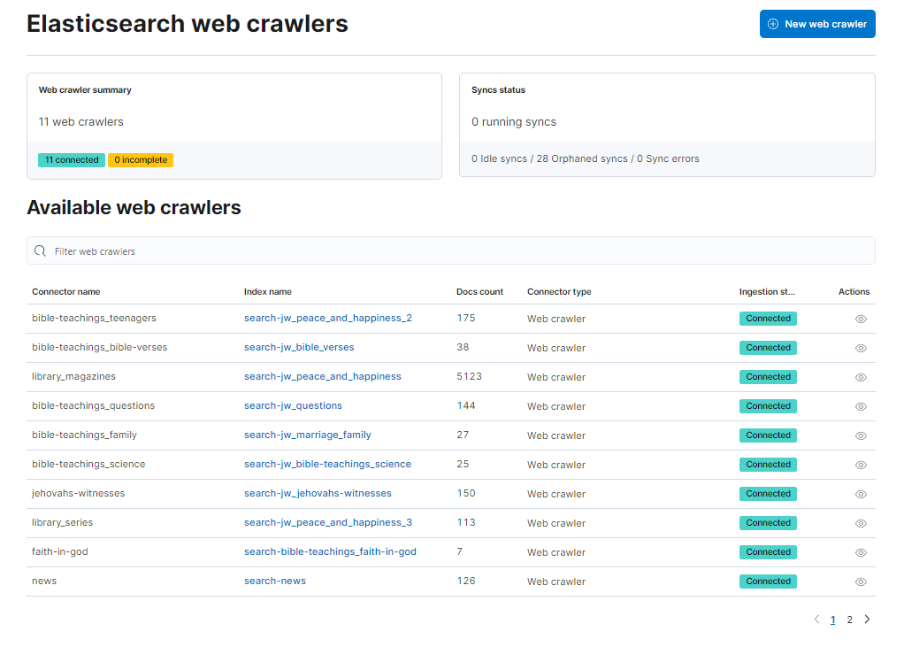
Elastic
Stack
Web crawlers
With the help of Elasticsearch Web Crawler, all articles, books, etc. are found in Elasticsearch index mode, which again makes it possible to search or query any of them even using natural language (like speaking in any smart chat), sections as teenagers, bible verses, library, magazines, questions and anwers, family, science, jehovahs witnesses, series, faith in god, news, etc.

Slide 7
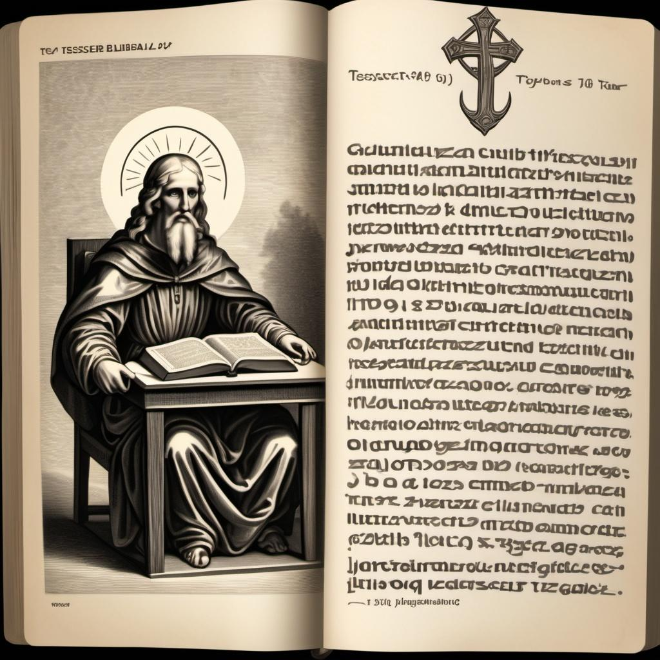


Tesseract
The Work of Tesseract OCR in the Extraction and Translation of Biblical Texts:
Tesseract OCR is an open source tool that converts images of text into editable text, it is used to digitize manuscripts and printed documents, then the extracted text is translated from English to Spanish and Portuguese, using artificial intelligence tools for machine translation, this allows biblical texts to be accessible to a wider audience and facilitates comparative study in different languages.

Slide 8
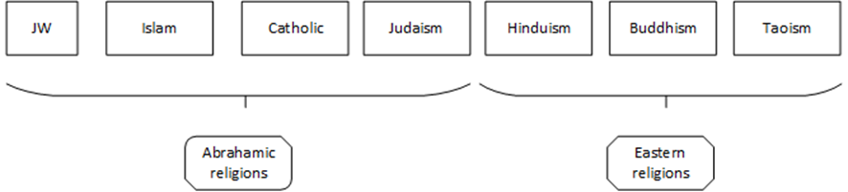
Image/text classification if religious images
Experiment: automatic labeling of a religious image into one of seven classes, according to this taxonomy.
The decision is made by comparing the distance between two sets of vectors: one representing the image and the other representing the text description of religions.
The vectors were created using models from OpenAI (visual transformer CLIP-ViT-B-32 and a variant), available in HuggingFace.
Example for JW: "Known for distinctive beliefs, emphasizing evangelism and community outreach, rejecting military service and political involvement"

Slide 9
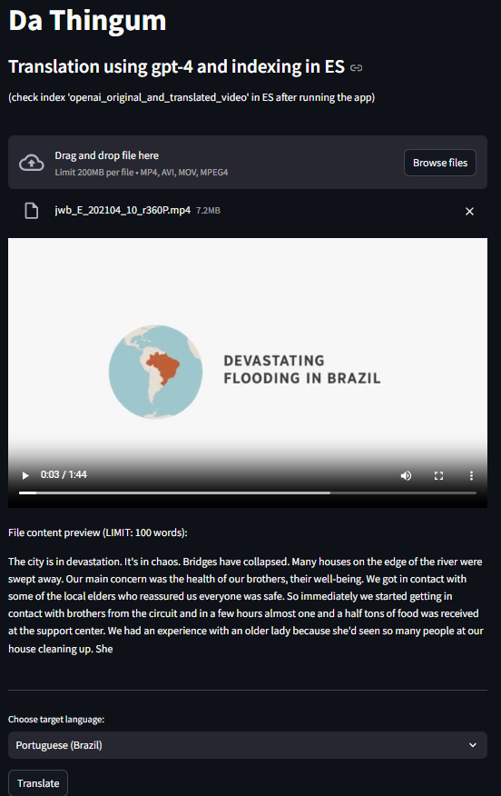
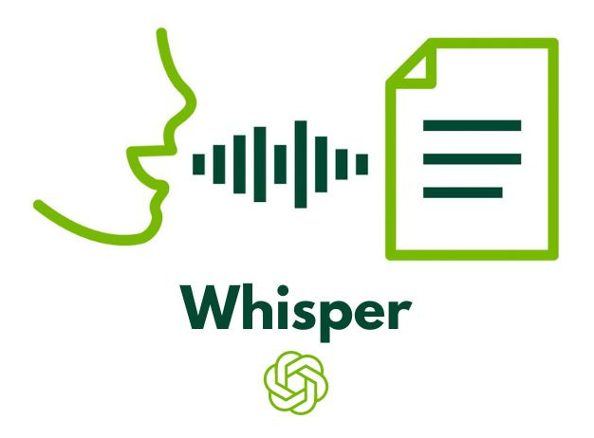
Open AI for audio
Audio to text: conversion using whisper from audio files (e.g., podcasts) or audio tracks from videos.
POC in streamlit webapp:
Load video with English speech
Audio extraction and conversion to text
Text translation using gpt-4o to target language
Saving of results in Elasticsearch
NOTE: similar webapps were developed for other documents → txt, word, pdf, youtube links.

Slide 10
LARGE LANGUAGE MODELS

Slide 11
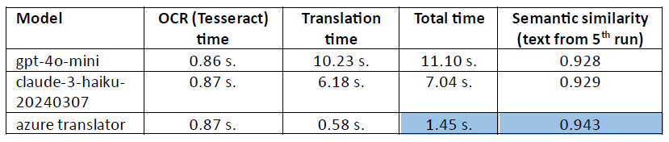
Model comparison
LLMs:
OpenAI models: gpt-3.5, gpt-4-turbo, gpt-4o-mini, gpt-4o
ClaudeAI: haiku.
Azure AI Translator
Best results for Brazilian Portuguese:
Source: Page 1 of Daily texts (January 1st to January 3rd)
Best model for each LLM provider reported.
Average times on 5 runs:

Slide 12
Azure AI translator API
LLM with best performance in both, time and semantic similarity.
Result ‘as-is’, given that it is not prompt-based.
Alternative to try (future work) - Custom translator:
Fine-tuning of default model with a minimum of 10,000 paired sentences in original and target language.
According to official documentation, the process allows the neural translation system to understand and adapt to the terminology used in own industry.

Slide 13
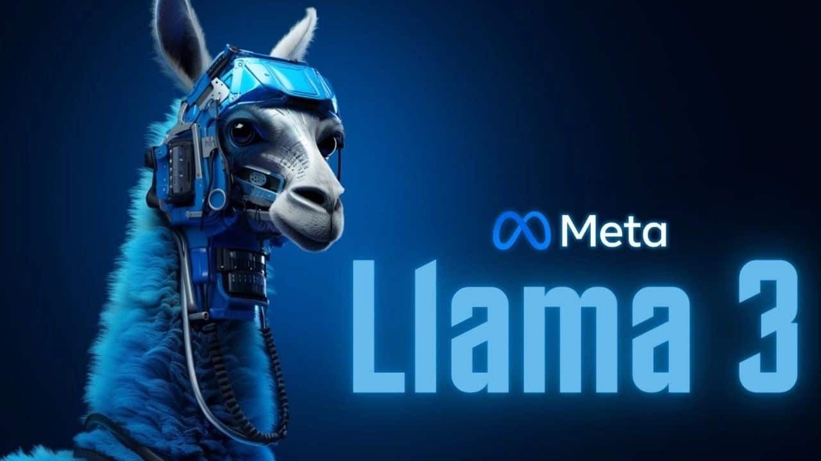
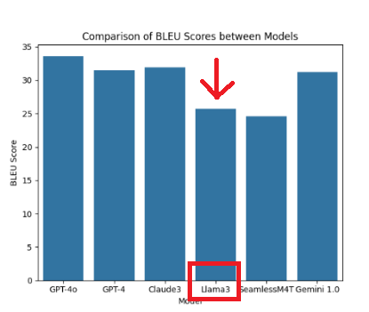
Llama 3
Llama 3 is a large language model (LLM) developed by Meta AI. It is an open-source model designed to compete with other advanced models such as GPT-4 and Claude 3.5. Llama 3 is used for a variety of tasks including text generation, language translation, and code writing.
The LLaMA 3 model did not have the same level of efficiency when translating text from English to Hawaiian Pidgin compared to other models such as OpenAI-4o, GPT-4, Claude 3, and Gemini.

Slide 14

Hugging Face models
flan-t5-base-eng-hwp
The “claudiatang/flan-t5-base-eng-hwp” model in Hugging Face was not considered efficient at translating English to Hawaiian Pidgin due to several limitations:
Unknown phrases: It had difficulty translating certain phrases in Hawaiian Pidgin that were not present in the training dataset.
Long sentences: The model showed problems handling longer sentences, resulting in less accurate translations.
These limitations contributed to the model not reaching an adequate level of efficiency for the translation task.

